Slide 1
What can I do with Python?
Pretty much everything…
Today, Python is written into many popular software and web-based applications. You'd be surprised in fact to know that many of the web applications that you use on a daily basis were written partially or entirely in Python. In general, Python development can be broken down into several categories that include:
Systems / Console / Terminal Programming
Desktop / GUI Applications (with Tkinter, etc.)
Network and Web Programming (with Django, Flask, Pylons, Pyramid, etc.)
Games (EVE Online, Battlefield 2, Civilization IV, many Disney games, Raspberry PI)
Database Programming
Data Mining
Robotics
Artificial Intelligence
General Software Development and much more!

Slide 2
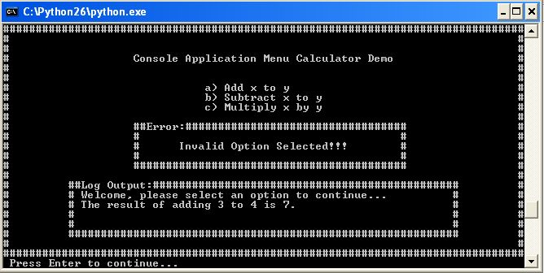
What can I do with Python?
Systems, Console, and Terminal Programming
Unless you see people working in technical fields on a regular basis, you probably haven't seen many people using console / terminal applications. Python’s built-in interfaces to operating-system services though, make it ideal for writing portable, maintainable system-administration tools and utilities (sometimes called shell tools) that run entirely in the console / terminal. Here’s an example of what a console / terminal application could look like:

Slide 3
What can I do with Python?
Desktop and GUI Applications
Python’s simplicity and rapid turnaround also make it a good match for Graphical User Interface (GUI) programming on the desktop.
Python comes with a standard object-oriented interface called Tkinter that allows Python programs to implement portable GUIs with a native look and feel.
Python/Tkinter GUIs run on Microsoft Windows, X Windows (on Unix and Linux), and the Mac OS (both Classic and OS X).
A free extension package, PMW, adds advanced widgets to the Tkinter toolkit.

Slide 4
What can I do with Python?
Database Programming
For traditional database development, there are Python interfaces to all commonly used relational database systems including Sybase, Oracle, Informix, MySQL, PostgreSQL, SQLite, SQL Server, and more.
For non-SQL development, Python provides a simple object persistence system - it allows programs to easily save and restore entire Python objects to files and file-like objects. Third party, open source systems like ZODB and Durus provide complete object-oriented database systems for Python scripts.
Other options include PyMongo which is an interface to the hugely popular MongoDB, a JSON-style document-oriented database which stores data in structures very similar to Python’s own lists and dictionaries.

Slide 5

What can I do with Python?
Network and Web Programming
Python comes with standard Internet modules that allow Python programs to perform a wide variety of networking tasks in client and server modes.
Scripts can communicate over sockets; extract form information sent to server-side scripts; transfer files by FTP; parse and generate XML and JSON documents; send, receive, compose, and parse email; fetch web pages by URLs; parse the HTML of fetched web pages; communicate over XML-RPC, SOAP, and Telnet; and more.
One popular tool that utilizes Python and the standard Internet modules is BitTorrent.

Slide 6
What can I do with Python?
Network and Web Programming
Some of the most popular and widely used websites and applications that you use every day are built using Python and open-source Python frameworks like Django, Pylons, Flask, Zope, and more. The success of these applications shows the power and popularity of the Python language and associated frameworks.
YouTube
DropBox
Survey Monkey
Google
Bitly
Reddit
Firefox
Yahoo Maps
Pinterest
The Onion
Instagram
Disqus
NASA
The Washington Post
Spotify
…and more

Slide 7
What can I do with Python?
Games
Although Python doesn't excel in the area of game development, it has seen success in this field. Utilizing the PyGame module and numerous freely available third-party libraries, popular games utilizing Python have emerged. Additionally, kids have taken to learning Python in conjunction with Raspberry PI development.
Battlefield 2
EVE Online
Sid Meier's Civilization IV
Disney's Toontown
Disney's Pirates of the Caribbean
Little Mermaid, Aladdin, and Pirates Pinball
…and many more

Slide 8
What can I do with Python?
General Software Development
Python is commonly applied in more disciplines than can be covered here. For example, you’ll find third-party tools that allow you to use Python to do serial port communications, image processing, robot control programming, natural language analysis, instrumentation, mobile computing, Excel spreadsheet development, media file content and metadata processing, artificial intelligence, systems programming, network monitoring, 3D design and modelling, data visualization, XML parsing, JSON and CSV file processing, and more!

